Slide 1

ModelIt!
Student Lesson
When Trees Become Matches
California's Burning Season and the Earth Systems That Fuel It
NGSS: 5-ESS2-1
5th Grade
1/8

Slide 2
What You Will Learn Today
Learning Goals
* Identify the parts of California's fire system
* Explain how Earth's systems (water, air, land, life) interact
* Build a model showing cause-and-effect relationships
* Use simulations to predict what happens during drought
Key Vocabulary
Component
a part of a system
Relationship
how parts affect each other
Simulation
running a model to see what happens
Earth System
geosphere, hydrosphere, biosphere, atmosphere
2/8

Slide 3
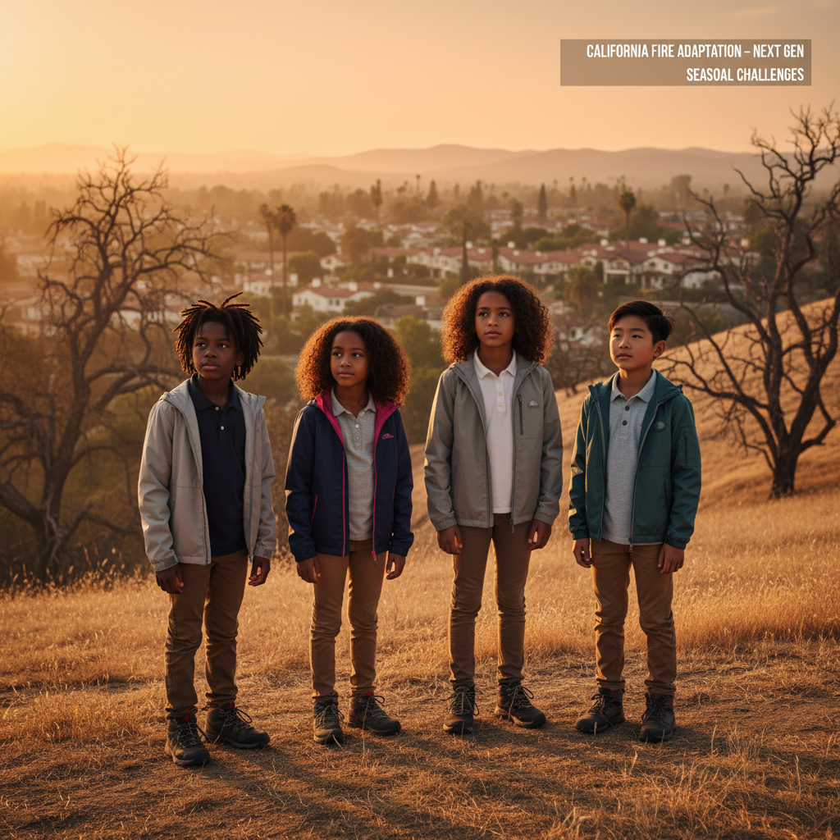
The Big Question
Why does California burn at the same time every year?
Every fall, California faces massive wildfires. But why fall? Why not spring or winter? Today we'll build a MODEL to discover the answer!
3/8

Slide 4

Today We Will Build a Model!
A model helps us understand complex systems!
1. LOCATE
Identify the COMPONENTS (parts) of the fire system
2. ESTABLISH
Connect them with RELATIONSHIPS (+ or -)
3. VISUALIZE
Build your model in ModelIt!
4. EVALUATE
Run SIMULATIONS to test scenarios
5. REVISE
Improve your model based on evidence
4/8

Slide 5
Activity 1: Sort the Components
Sort these components into EXTERNAL (inputs from outside) and INTERNAL (inside the system):
Your Components:
* Rainfall
* Dry Vegetation
* Wind
* Fire Spread
[ModelIt Platform Screenshot - Sorting Activity]
Think: Which components can we control? Which happen on their own?
5/8

Slide 6

Activity 2: Connect with Arrows
Draw arrows to show HOW components affect each other:
(+) POSITIVE Relationship
When one goes UP, the other goes UP too
(-) NEGATIVE Relationship
When one goes UP, the other goes DOWN
Think About It:
When RAINFALL increases, does DRY VEGETATION increase or decrease?
6/8

Slide 7
Activity 3: Run the Simulation!
Test these scenarios in ModelIt!
Scenario 1: DROUGHT
Turn RAINFALL to OFF
Scenario 2: WINDY DAY
Turn WIND to ON
Scenario 3: FIRE SEASON
RAINFALL OFF + WIND ON
Watch the activity graphs change!
[ModelIt Platform Screenshot - Simulation Results Graph]
7/8

Slide 8
What Did We Discover?
Our Model Showed Us:
* California's dry season = more dry vegetation = more fire risk
* Drought makes vegetation into FUEL for fires
* Wind helps fire SPREAD faster and farther
* These Earth systems work TOGETHER to create fire conditions
Answer: California burns in fall because summer drought dries out vegetation (FUEL), and fall brings Santa Ana winds that spread fire rapidly!
8/8

Slide 9

STEM Challenge: Firebreak Engineers!
YOUR ENGINEERING MISSION
You learned that DRY VEGETATION is FUEL. Real engineers create FIREBREAKS - areas with no fuel - to stop fires!
The Challenge:
Design firebreaks to protect Willow Creek from wildfire. You have a budget for only 3 firebreaks.
Think Like an Engineer:
* Which direction does wind blow? (From the east!)
* Does fire spread uphill or downhill faster?
* Where should firebreaks go to protect the town?
9/8

